Slide 1
DETECTING-PHISING-WEBSITE
K.SINDHU PRIYA
228W1F0056
PROJECT GUIDE: M.PRASANA LAKSHMI

Slide 2

ABSTRACT
Phishing costs Internet users billions of dollars per year. It refers to luring techniques used by identity thieves to fish for personal information in a pond of unsuspecting internet users. Phishers use spoofed e-mail, phishing software to steal personal information and financial account details such as usernames and passwords. This paper deals with methods for detecting phishing web sites by analyzing various features of benign and phishing URLs by Machine learning techniques. We discuss the methods used for detection of phishing websites based on lexical features, host properties and page importance properties.
The system is based on a machine learning method, particularly supervised learning. I have selected the Random Forest technique and Logistic regression due to its good performance in classification.
As a result , with accuracy of 97% using Random Forest and 92% accuracy using Logistic regression

Slide 3
Justification For Selecting The Title
The main purpose of the project is to detect a website created by any phisher for hacking data from a user and making aware the user of such threats once detected. It proposes to prove much beneficial for users for safe browsing and keeping their data untouched by any phisher who is trying to use the user’s credentials in illegal means.
So the title mentioned clearly gives the ideology and goal of our project i.e. “Phishing Website Detector Using ML)”Justification For Selecting The Title

Slide 4
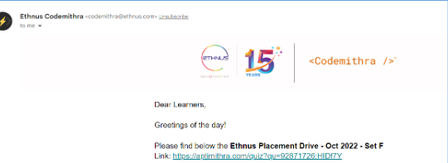

Examples of Phishing Websites
Phishing Website send via mail:
Phishing Website sent via SMS-

Slide 5
EXISTING SYSTEM
In the existing models have low latency. Existing systems do not have a specific user interface. In the current system, different algorithms are not compared.
The Decision Tree model provided detection accuracy rate at 96%
The Support vector Machine accuracy rate at 94%

Slide 6
PROPOSED SYSTEM
To enhance detection method to detect phishing websites using machine learning technology. We achieved 97.14% detection accuracy using random forest algorithm with lowest false positive rate. Also result shows that classifiers give better performance when we used more data as training data.

Slide 7

Proposed Approach:-
Collection of Data
Split the Data Into Train and Test set
Build The Model
Train the Model
Results
Deploy The Model
Import Links To Prediction

Slide 8


WHY I CHOOSE RANDOM FOREST AND LOGISTIC REGRESSION?
DT
SVM
?
LOGISTIC REGRESSION
RANDOM FOREST

Slide 9
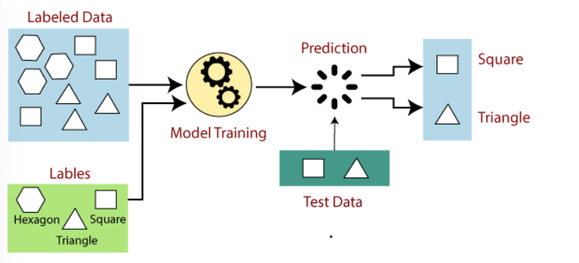
Supervised Machine Learning
Supervised learning is the types of machine learning in which machines are trained using well "labelled" training data, and on basis of that data, machines predict the output. The labelled data means some input data is already tagged with the correct output.
In the real-world, supervised learning can be used for Risk Assessment, Image classification, Fraud Detection, spam filtering, etc.

Slide 10
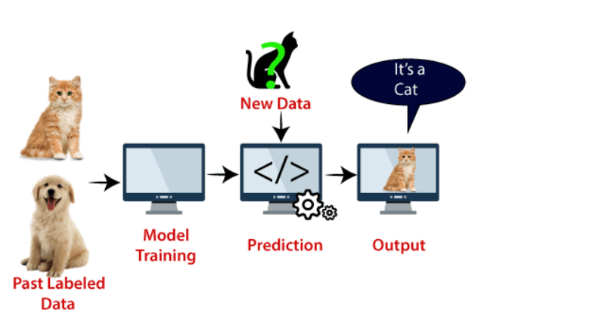
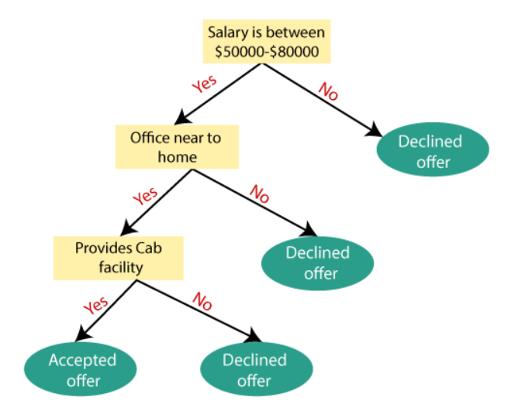
Decision Tree
Support Vector Machine
Decision Tree is a Supervised learning technique that can be used for both classification and Regression problems, but mostly it is preferred for solving Classification problems. It is a tree-structured classifier, where internal nodes represent the features of a dataset, branches represent the decision rules and each leaf node represents the outcome.
In a Decision tree, there are two nodes, which are the Decision Node and Leaf Node. Decision nodes are used to make any decision and have multiple branches, whereas Leaf nodes are the output of those decisions and do not contain any further branches.
Support Vector Machine or SVM is one of the most popular Supervised Learning algorithms, which is used for Classification as well as Regression problems. However, primarily, it is used for Classification problems in Machine Learning.
The goal of the SVM algorithm is to create the best line or decision boundary that can segregate n-dimensional space into classes so that we can easily put the new data point in the correct category in the future. This best decision boundary is called a hyperplane.

Slide 11
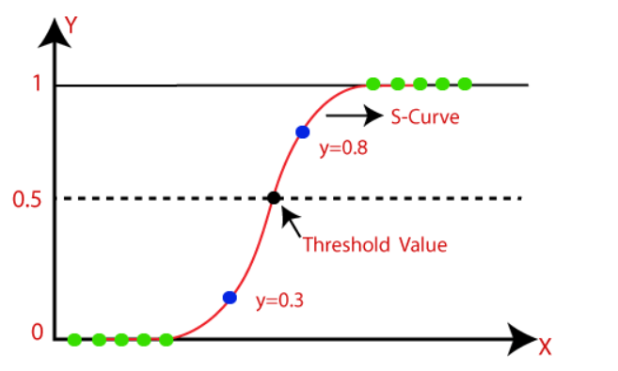
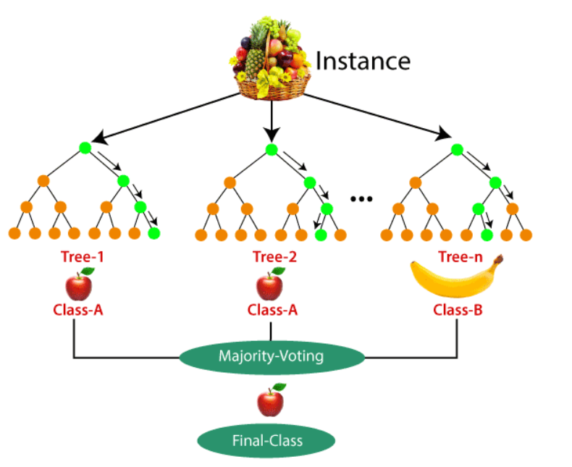
RANDOM FOREST
LOGISTIC REGRESSION
Random Forest is a popular machine learning algorithm that belongs to the supervised learning technique. It can be used for both Classification and Regression problems in ML. It is based on the concept of ensemble learning, which is a process of combining multiple classifiers to solve a complex problem and to improve the performance of the model.
As the name suggests, "Random Forest is a classifier that contains a number of decision trees on various subsets of the given dataset and takes the average to improve the predictive accuracy of that dataset." Instead of relying on one decision tree, the random forest takes the prediction from each tree and based on the majority votes of predictions, and it predicts the final output.
Logistic regression is one of the most popular Machine Learning algorithms, which comes under the Supervised Learning technique. It is used for predicting the categorical dependent variable using a given set of independent variables.
Logistic regression predicts the output of a categorical dependent variable. Therefore the outcome must be a categorical or discrete value. It can be either Yes or No, 0 or 1, true or False, etc. but instead of giving the exact value as 0 and 1, it gives the probabilistic values which lie between 0 and 1.

Slide 12
SYSTEM REQUIREMENTS
SOFTWARE REQUIREMENTS
HARDWARE REQUIREMENTS
Jupyter Notebook
Python
PyCharm
Google colb
GitHub
Computer/Laptop
Processer: i5 or more
8GB RAM
Operating System
Internet

Slide 13
FEATURE SELECTION The following category of features are selected :
Address Bar based
Abnormal Based
HTML and JavaScript based
Domain based

Slide 14
Address Bar based Features
Abnormal Based Features
Using the IP Address
Long URL to Hide the Suspicious Part
Using URL Shortening Services “Tiny URL”
URL’s having “@” Symbol
Redirecting using “//”
Adding Prefix or Suffix Separated by (-) to the Domain
Sub Domain and Multi Sub Domains
HTTPS (Hyper Text Transfer Protocol with Secure Sockets Layer)
Domain Registration Length
Request URL
URL of Anchor
Links in <Meta>, <Script> and <Link> tags
Server Form Handler (SFH)
Submitting Information to Email
Abnormal URL

Slide 15
HTML and JavaScript based Features
Domain based Features
Website Forwarding
Status Bar Customization
Disabling Right Click
Using Pop-up Window
I Frame Redirection
Age of Domain
DNS Record
Website Traffic
PageRank
Google Index
Number of Links Pointing to Page
Statistical-Reports Based Feature

Slide 16
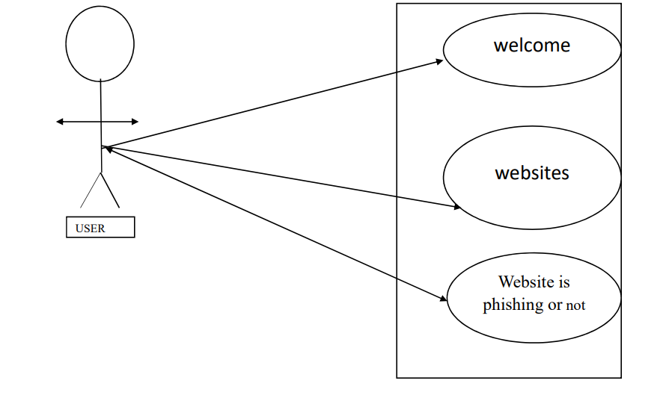
UML DIAGRAMS: USE CASE DIAGRAM

Slide 17
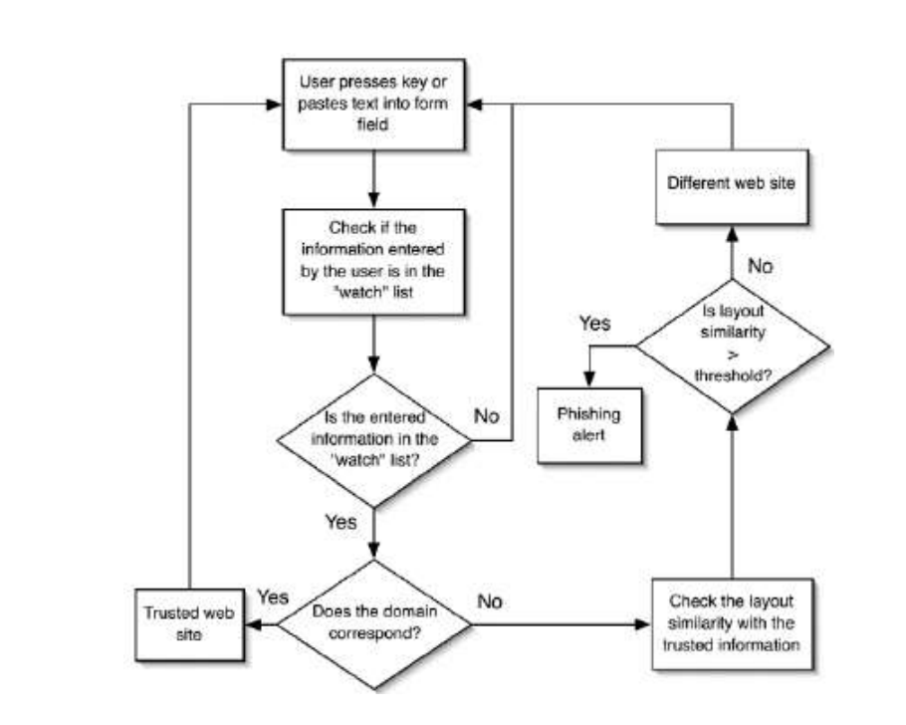
STATE DIAGRAM

Slide 18
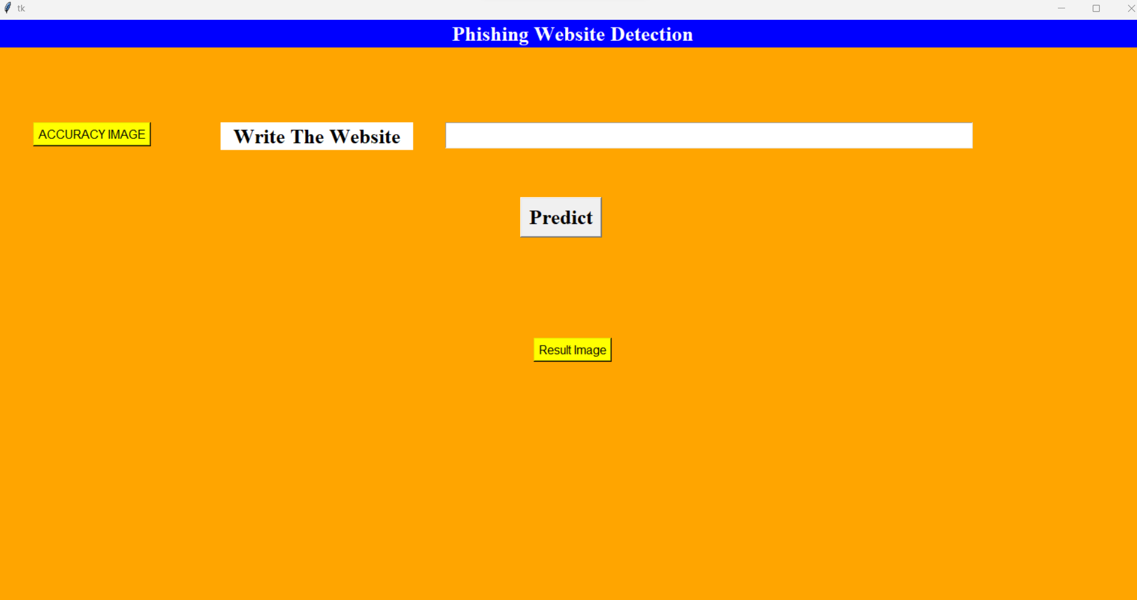
USER INTERFACE

Slide 19
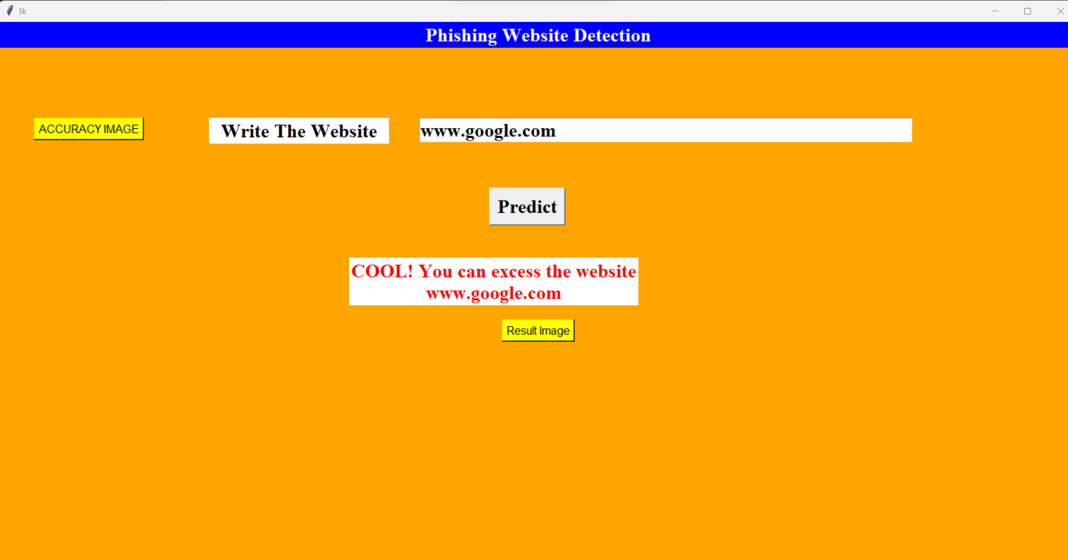
FOR SAFE WEBSITE

Slide 20
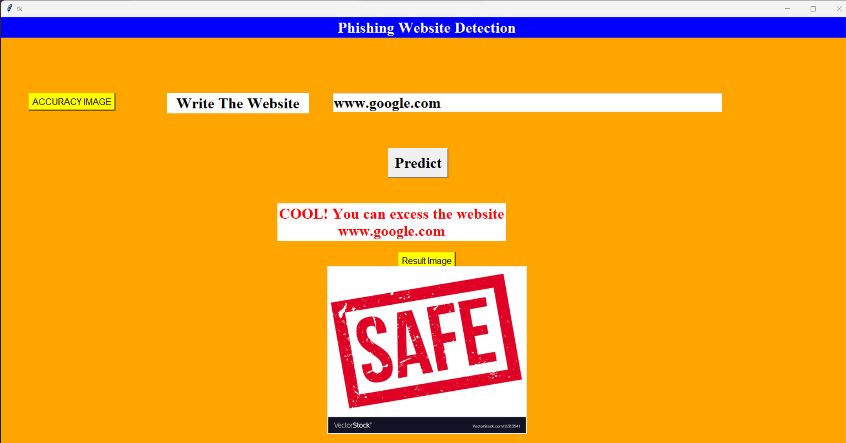
SAFE WEBSITE BY SHOWING AN RESULT IMAGE

Slide 21
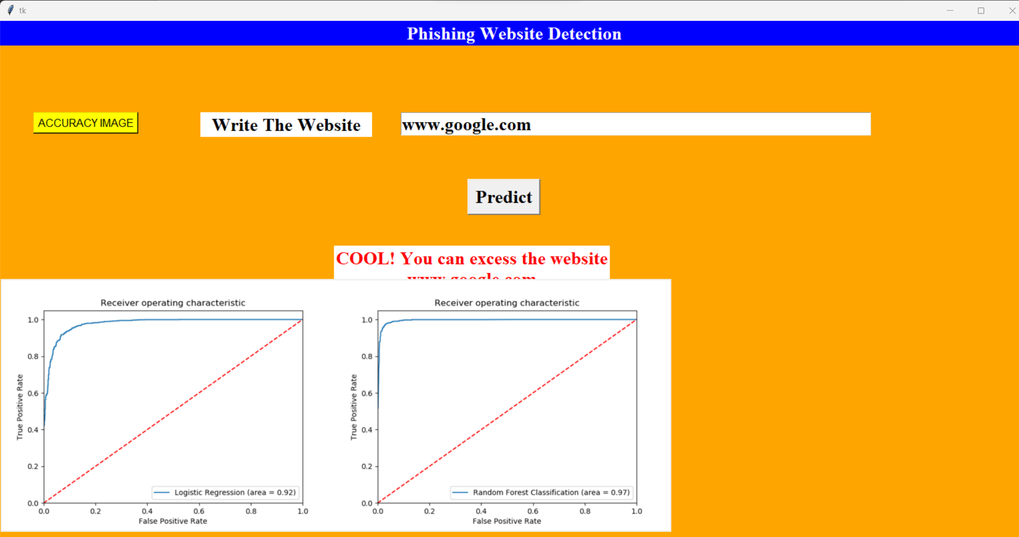
ACCURACY OF THE WEBSITE

Slide 22
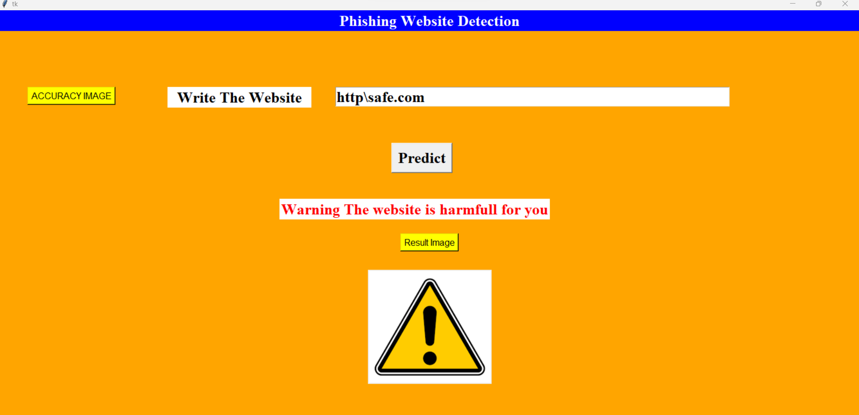
FOR HARMFUL WEBSITE

Slide 23
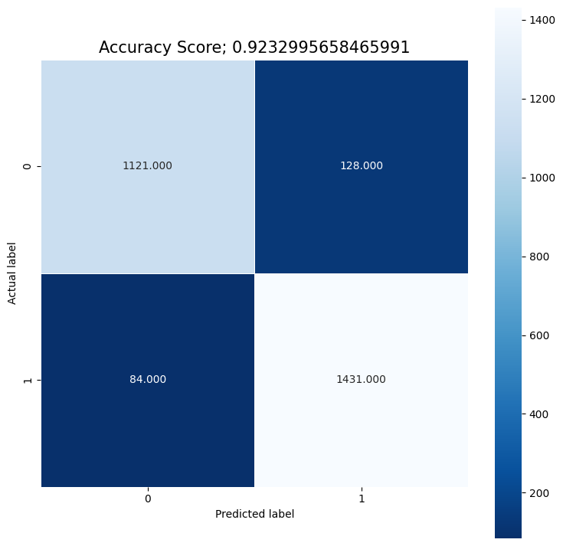
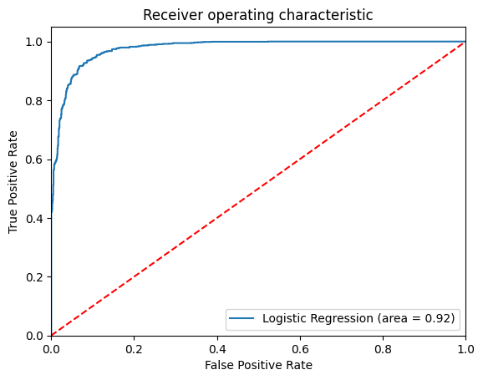
ACCURACY FOR LOGISTIC REGRESSION
The method we've introduced in our approach consistently demonstrates an impressive average accuracy rate of 92%.

Slide 24
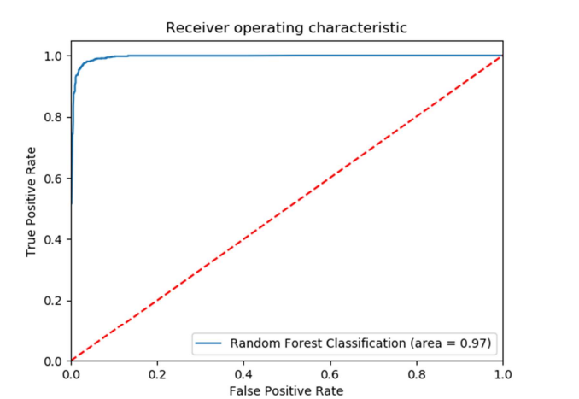
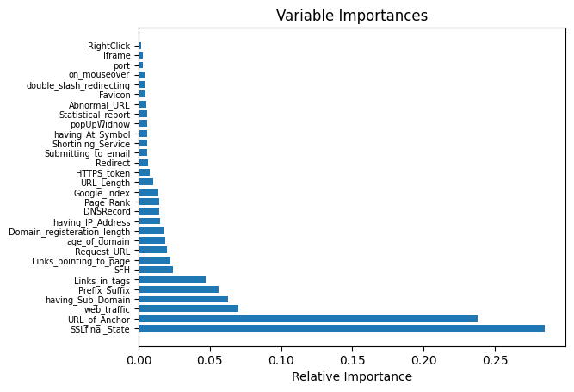
ACCURACY FOR RANDOM FOREST
The methodology we've put forward in our approach consistently achieves a noteworthy average accuracy rate of 97%.

Slide 25
CONCLUSION
The process of detecting phishing URLs involves two crucial steps. Firstly, we extract pertinent features from the URLs, and subsequently, we employ the developed model, trained on the training dataset, to classify these URLs.
In our study, we exclusively utilized a dataset that provided these pre-extracted features.
One significant challenge, particularly with decision tree classifiers, is the risk of overfitting. Decision trees often excel at classifying the training data but can underperform when applied to a testing dataset.
To elevate the effectiveness of our phishing website detection method, we turned to machine learning technology. Leveraging the Random Forest algorithm, we achieved an impressive 97% accuracy rate while simultaneously minimizing false positives. Our results underscore the advantages of using an algorithm that thrives on larger training datasets, as this approach yielded improved classifier performance. This development represents a significant stride in enhancing the detection of phishing websites through advanced machine learning techniques.

Slide 26
FUTURE SCOPE
It is important to note that the feature scope is a trade-off between accuracy and performance. A wider range of features can lead to better accuracy, but it can also make the model more complex and slower to train and predict. Therefore, it is important to choose a feature scope that is appropriate for the specific problem that you are trying to solve.
In the case of phishing website detection, a wider range of features could potentially lead to better accuracy, but it could also make the model more difficult to maintain and deploy. Therefore, it is important to carefully consider the trade-offs before choosing a feature scope.

Slide 27


Slide 28
THANK YOU -K.SINDHU PRIYA

